Slide 1
Team : Fab Five
Wahab
Niful Islam
Yeasir Arafat
01
02
04
Sunny Sutradhar
Azizul Islam Nayem
04
05
011193058
011201057
011201035
011201084
011201262

Slide 2
ETHICA.SOCIAL
Be Safe, Keep Safe
Notes:
Ethics,
Structured life

Slide 3

Short Description
This system is a social media for those who are concerned about their mental health and data privacy. There will be various method of communication so that they can talk to their close relatives for some time of the day. And there will be also some entertainment options so that they can forget all the tiredness and open their minds in an ethical environment and smile with not being addicted.
The biggest advantage of our platform is that we are aware enough about the mental health of the people, due to which our application cannot be used even if we want to after a certain period of time. Our media will be a symbol of credibility and trust.

Slide 4
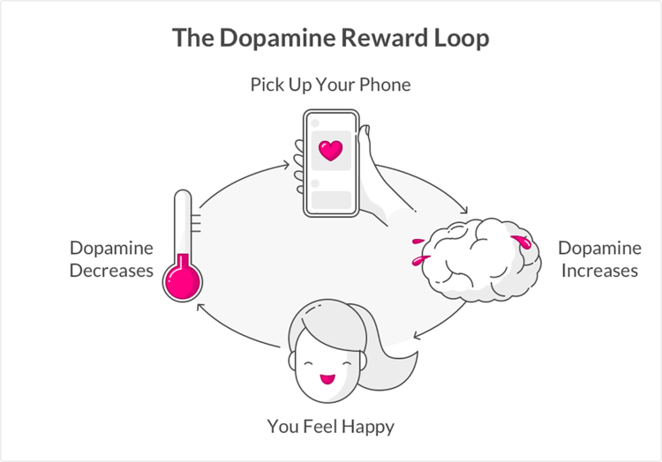
Things that motivated us

Slide 5
Facebook Files by Frances Haugen
Instagram's harmful effects on teenagers
"we make body issues worse for one in three teenage girls"
Violence in developing countries
Promoting anger-provoking posts
“Posts that get angry react is five times more
likely to reach to a larger audience”

Slide 6
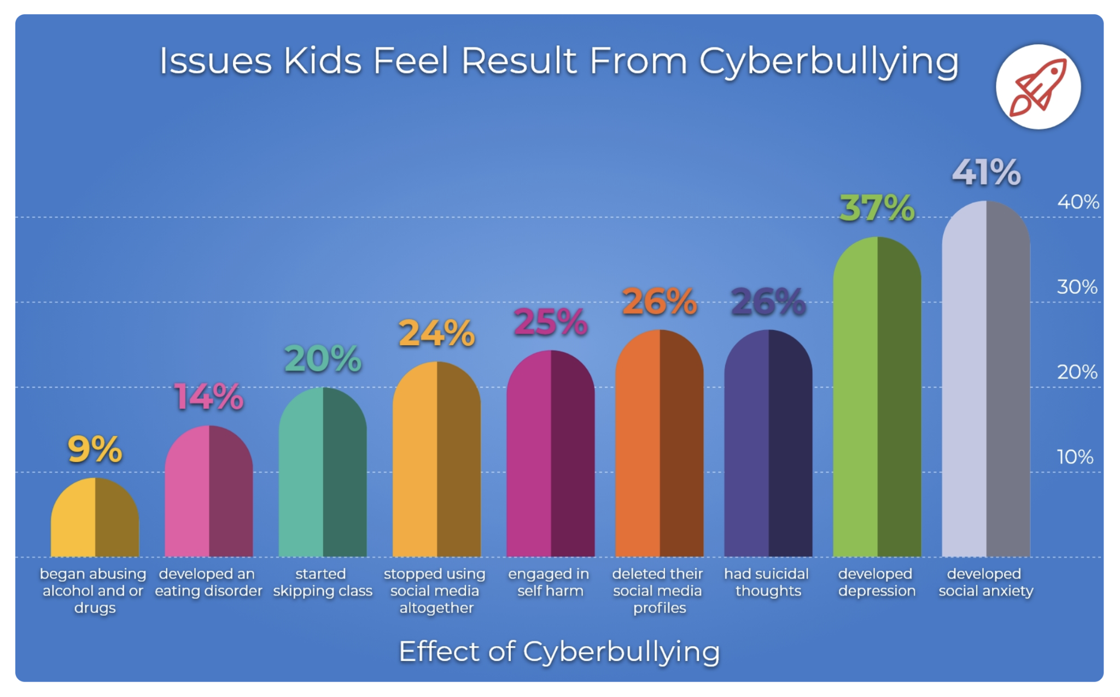

Slide 7
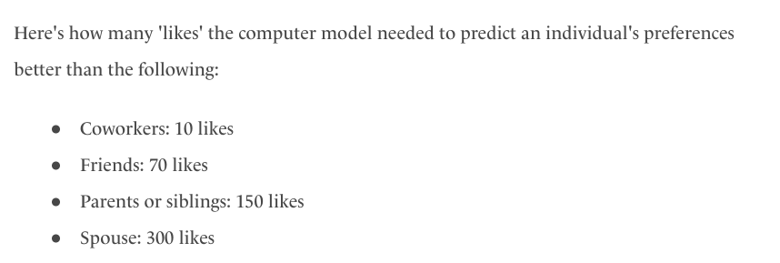
Company That Owns Your Data,
OWNS YOU

Slide 8
Motivation
There are many types of social media platforms in the world, but they are basically full of business ideas. They never think about whether people are using these platforms to disseminate accurate information, whether the security of human information is being ensured, whether the overuse is hampering the development of human mental health.
We believe that we will try to solve the above problems very carefully, we will do everything possible in the near future to build our platform as a safe and secure means of communication as much as possible.

Slide 9
Benchmark Analysis
Features | Facebook | Youtube | Twitter | Instagram | Snapchat | ethica.social
AI Based Post Suggestion | YES | YES | YES | YES | YES | YES
Follow | YES | YES | YES | YES | YES | YES
Shop | YES | NO | NO | YES | NO | YES
Customized Reaction | YES | NO | YES | NO | YES | YES
Hide Reaction | YES | YES | NO | YES | NO | YES
Show Opposite View | NO | NO | NO | NO | NO | YES
Blood Donation | YES | NO | YES | YES | NO | YES
Notes:
sunny→shop , call message, trusted news

Slide 10
Benchmark Analysis
Features | Facebook | Youtube | Twitter | Instagram | Snapchat | ethica.social
Ads. | YES | YES | YES | YES | YES | NO
Search | YES | YES | YES | YES | YES | YES
Nested Comment | YES | NO | NO | NO | NO | YES
Putting Tag | NO | YES | NO | NO | NO | YES
AI based Text Recognition | YES | YES | YES | YES | YES | YES
Job Finding | YES | YES | YES | YES | YES | YES
App Using Limit | NO | NO | NO | NO | NO | YES

Slide 11
Benchmark Analysis
Features | Facebook | Youtube | Twitter | Instagram | Snapchat | ethica.social
Maximum Post View Limit | NO | NO | NO | NO | NO | YES
Call And Messaging | YES | NO | YES | YES | YES | YES
Survey | YES | YES | YES | YES | YES | YES
Sell Data | NO | NO | NO | NO | NO | YES
Paid Post | NO | YES | NO | NO | NO | YES
Disappearing message | YES | NO | YES | YES | NO | NO

Slide 12
Benchmark Analysis
Features | Facebook | Youtube | Twitter | Instagram | Snapchat | ethica.social
Premium Only | NO | NO | NO | NO | NO | NO
Notification | YES | YES | YES | YES | YES | YES
Rating & Review | YES | YES | YES | YES | YES | YES
Mandatory Nid Verification | NO | NO | NO | NO | NO | YES
Tips | YES | YES | NO | NO | NO | YES
Trusted News | NO | NO | NO | NO | NO | YES
Notes:
Yasir→ notification,activity log, blood donation, tips , search (both post and person) , review

Slide 13
Feature Description
AI Based Post Suggestion:
Observe the personality first, gather some information and suggest post as per choice
Customized Reaction:
User will have certain reaction button such as like, angry, happy,fear ,sad, surprised. If a user wants not to get angry reaction on his post , he can do so
Show Opposite View:
A certain incident may have different perspective. Getting to see only the one side will make people biased. So he will be suggested other views as well
Blood Donation:
People may ask for blood and the post will be shown to respected blood group people

Slide 14
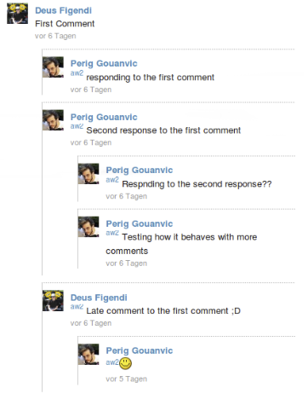
Feature Description
Nested Comment:

Slide 15
Feature Description
Putting Tag:
Post Admin can set tag in every post like youtube
AI based Text Recognition:
Our Ai model learn form Text/Post topic and suggest user who interested in which post/topic.
App Using Limit:
User can set site using time limit for every day/week after finishing the limit that user can’t login his /her account.
Sell Data:
If any user want to sell data anonymously and anyone can buy that for resource purpose.

Slide 16
Feature Description
Paid Post:
If any one wants to get paid for his post then he/she can use paid post option. User who wants to read paid post he/she have paid first then he/she can read that post.
Mandatory Nid Verification:
Every user have to verified his/her account via the national id card.
Tips:
Any user can pay tips if he/she wants to send tips of the post admin.
Trusted News:
This feature will be controlled by ethica.social. We make can another department with some expart people and collect verifted news from all over the world/internet and post in this section.

Slide 17
Tools/Language/Frameworks/Programs:
JavaScript.
HTML
MongoDB
CSS
Bootstrap
Django
Figma
Jira
Git and Github

Slide 18

THANK YOU!!

Slide 19
Forgot Feature:
Activity log
Shop statistics
Paid :
reaction
Flag
Dp effect

